Slide 1

Stream temperature response to the climate change and water diversions for Marijuana Cultivation in Eel river
CZO retreat 2016
Dedi Liu， Yao Xu
E-mail: dediliu@whu.edu.cn
April, 2016

Slide 2
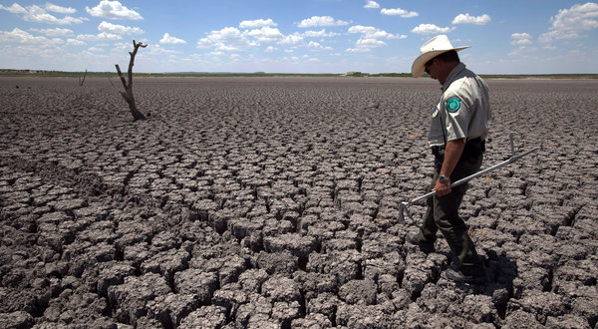
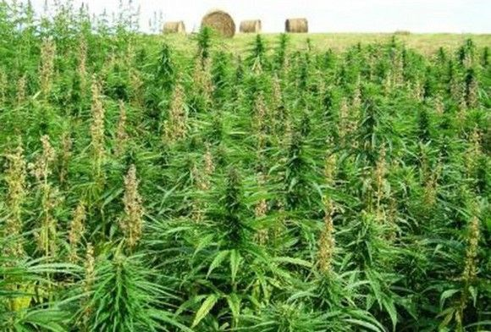
Motivation
Climate change, concentrated warming, is projected throughout the 21st century across the North America in CMIP5 experiments
Impacts of water diversion of marijuana cultivation on Aquatic Habitat is proved substantial

Slide 3
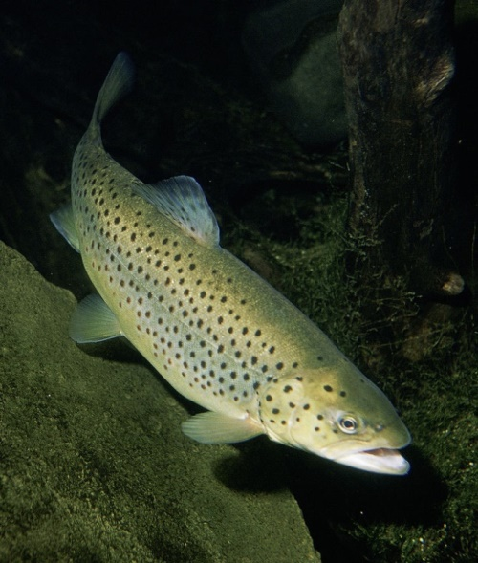
Motivation
Stream temperature, the primary driver of aquatic ecosystems , can greatly impact the survival of the creatures and is influenced by meteorological and hydrological factors
Impacts of climate change and water diversion on stream temperature haven’t been fully understood yet

Slide 4
Methodology
water diversion
Hydrological model (VIC)
Base flow
Land use、Soil Forcing
Direct runoff
Inputs
The ANN model
Climate change
Air temperature
Output
Stream temperature

Slide 5
The land surface is modeled as a grid of large (>>1km), flat, uniform cells
Sub-grid heterogeneity (e.g. elevation, land cover) is handled via statistical distributions
Inputs are time series of daily or sub-daily meteorological drivers (e.g. precipitation, air temperature, wind speed)
Land-atmosphere fluxes, and the water and energy balances at the land surface, are simulated at a daily or sub-daily time step
Water can only enter a grid cell via the atmosphere
Non-channel flow between grid cells is ignored
The portions of surface and subsurface runoff that reach the local channel network within a grid cell are assumed to be >> the portions that cross grid cell boundaries into neighboring cells
Once water reaches the channel network, it is assumed to stay in the channel (it cannot flow back into the soil)
Grid cells are simulated independently of each other
Entire simulation is run for each grid cell separately, 1 grid cell at a time, rather than, for each time step, looping over all grid cells
Meteorological input data for each grid cell (for the entire simulation period) are read from a file specific to that grid cell
Time series of output variables for each grid cell (for the entire simulation period) are stored in files specific to that grid cell
Routing of stream flow is performed separately from the land surface simulation, using a separate model (typically the routing model of Lohmann et al., 1996 and 1998)

Slide 7
Flow Routing
Routing of stream flow (Figure 10) is performed separately from the land surface simulation, using a separate model, typically the routing model of Lohmann, et al. (1996; 1998)
Each grid cell is represented by a node in the channel network
The total runoff and baseflow from each grid cell is first convolved with a unit hydrograph representing the distribution of travel times of water from its points of origin to the channel network
Then, each grid cell's input into the channel network is routed through the channel using linearized St. Venant's equations

Slide 8
Data (meteorological data stream flow and temperature)
Observed stream flow and temperature data for the calibration and validation of the models
Observed meteorological data for the calibration and validation of the models (06/01/2007-07/31/2014)
Precipitation stations | Air temperature stations
ALD | ALD
CLO | -
EEL | EEL
ERC | ERC
FSW | -
LAY | LAY
LEG | -
MRD | -
ZENIA | ZENIA
- | SOD

Slide 9
Methodology
water diversion
Hydrological model (VIC)
Base flow
Land use、Soil Forcing
Direct runoff
Inputs
The ANN model
Climate change
Air temperature
Output
Stream temperature
ANN- artificial neural network empirical procedure

Slide 10
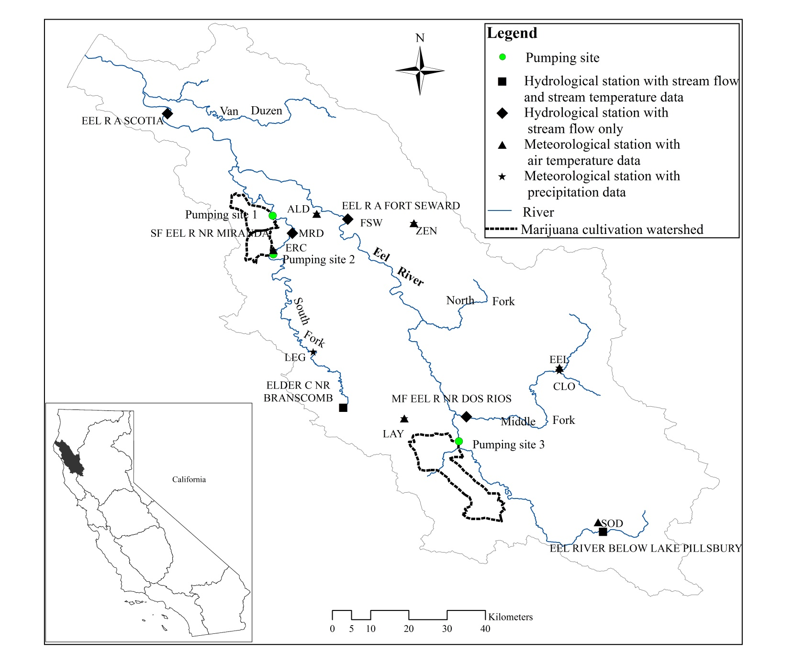
Data (meteorological data stream flow and temperature)

Slide 11
Data (climate change from Rcp 4.5 and 8.5)
Daily air temperature and precipitation changes between the observed data and the future data under two representative concentration pathways (RCPs) in the future periods
 |  |  | Rcp4.5 |  |  | Rcp8.5
 |  | Units | 2058-2065 | 2093-2100 |  | 2058-2065 | 2093-2100
Daily air temperature | maximum | ℃ | +2.21 | +2.93 |  | +2.77 | +4.84
 | minimum | ℃ | +2.18 | +2.86 |  | +2.74 | +4.76
 | average | ℃ | +2.20 | +2.90 |  | +2.76 | +4.8
Daily precipitation | summer | % | -25.14 | -24.66 |  | -27.90 | -33.14
 | winter | % | +0.12 | +1.17 |  | +0.34 | +4.77
The future meteorological data under RCP 4.5 and RCP 8.5 are from the reference as following:
Sheehan T, Bachelet D, Ferschweiler K. Projected major fire and vegetation changes in the Pacific Northwest of the conterminous United States under selected CMIP5 climate futures[J]. Ecological Modelling, 2015, 317: 16-29

Slide 12
Data (water diversion for the marijuana cultivation )
The total annual water consumption of marijuana cultivation during the growing season (June-October)
The data of the water consumption of marijuana was based on the following paper: Bauer S, Olson J, Cockrill A, et al. Impacts of surface water diversions for marijuana cultivation on aquatic habitat in four northwestern California watersheds[J]. PloS one, 2015, 10(3): e0120016.

Slide 13
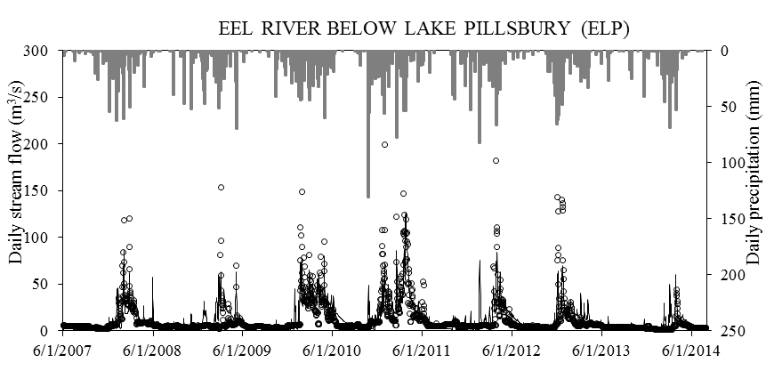
Results and discussion
Calibration and validation of the hydrological model (VIC) for stream flow
 |  | ELP | ELD
Calibration (2007/06/01 -2012/05/08) | NSE | 0.64 | 0.77
 | R² | 0.64 | 0.79
Validation (2012/05/09 to 2014/07/31) | NSE | 0.52 | 0.71
 | R² | 0.53 | 0.71
NSE: the Nash-Sutcliffe efficiency
R²: the square of correlation coefficient
When the NSE and R² are bigger than 0.5, the model can be used for the simulation of the hydrological process.

Slide 14
Results and discussion
Validation of the stream flow simulation using the parameters calibrated from ELP and ELD data set.
Station | NSE | R²
EEL R A SCOTIA CA | 0.79 | 0.80
EEL R A FORT SEWARD CA | 0.74 | 0.76
MF EEL R NR DOS RIOS CA | 0.57 | 0.63
SF EEL R NR MIRANDA CA | 0.80 | 0.81
The calibrated hydrological model can be used for the simulation of the hydrological process in Eel river basin.

Slide 15
Results and discussion
Calibration and validation of stream temperature
 |  | Calibration |  |  | Validation
Station |  | NSE | R² |  | NSE | R²
ELP | Linear regression | 0.45 | 0.45 |  | 0.48 | 0.60
ELD |  | 0.85 | 0.85 |  | 0.85 | 0.92
ELP | ANN | 0.7 | 0.7 |  | 0.7 | 0.78
ELD |  | 0.93 | 0.93 |  | 0.91 | 0.95
The performance of the ANN model is much better than the linear regression model
The ANN model can be used for the simulation of the stream temperature in Eel river basin.

Slide 16
Results and discussion
The impacts of climate change on steam temperature
At the ELP and ELD stations
 | Historical values | Rcp4.5 |  |  | Rcp8.5
ELP | 2007-2014 | 2058-2065 | 2093-2100 |  | 2058-2065 | 2093-2100
Summer | 14.23 | +1.16 | +1.37 |  | +1.33 | +1.84
Winter | 4.97 | +1.48 | +1.86 |  | +1.79 | +2.78
ELD | 2012-2014 | 2063-2065 | 2098-2100 |  | 2063-2065 | 2098-2100
Summer | 15.64 | +0.68 | +1.03 |  | +0.95 | +1.68
Winter | 6.07 | +2.13 | +2.50 |  | +2.42 | +3.50
The increase of the summer stream temperature at the ELP station is larger than that at the ELD station

Slide 17
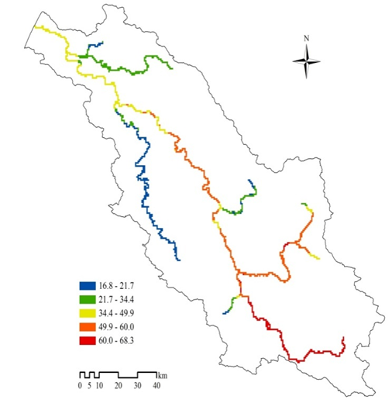
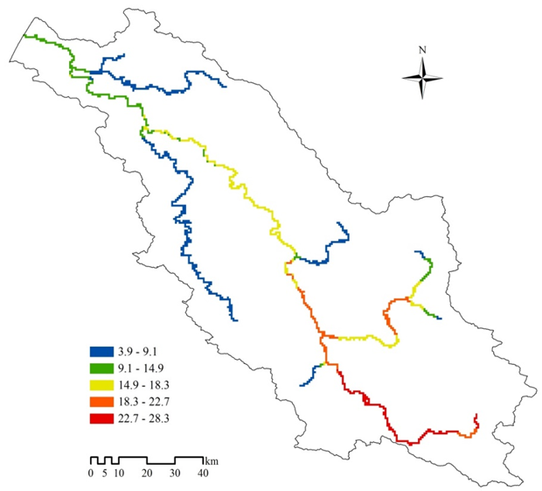
The future stream flow in summer change along the Eel River (RCP 8.5)
The amount of summer stream flow decrease (%)
The proportion of base flow in summer increase (%)

Slide 18
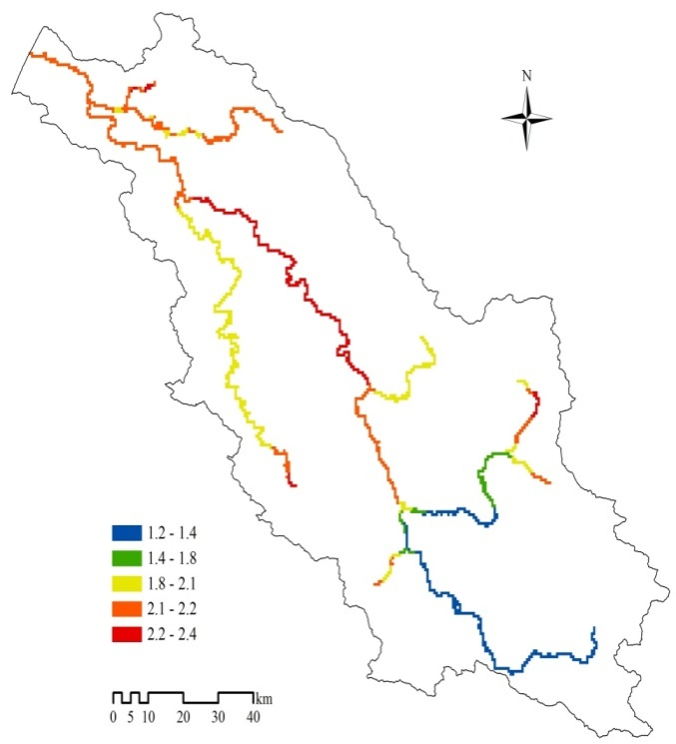
The future stream temperature in summer change along the Eel River(RCP 8.5)
The lowest increase in the upstream and the highest in the midstream
The increase of the proportion of the base flow is the major factor for the increase of stream temperature except the air temperature.
The average stream temperature increase in summer (℃)

Slide 19
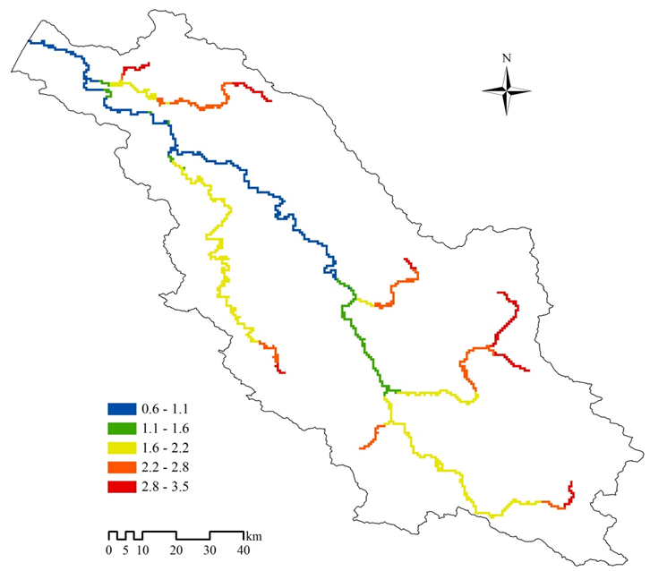
The future stream temperature in summer change along the Eel River (RCP 8.5)
The increase of the future stream temperature in winter is less than that in summer
The amount of stream flow is the first factor except air temperature on the stream temperature increase
The average stream temperature increase in winter (℃)

Slide 20
The future stream temperature will increase due to the increase of air temperature under the climate change
The extent of the increase of stream temperature is also influenced by the proportion of base flow in summer and the amount of the stream flow under the climate change

Slide 21
The future stream temperature under the different ways of irrigation for the marijuana cultivation
The ways of irrigation for marijuana are not available for us. If the pumping rate is fixed and the pump machine works 6 hours for every pumping day. 4 types of irrigation ways are assumed in our study.
The low-intensity irrigation (Ⅰ)：Only the base flow is pumped and the pumping rate is 0.05m³/s.
The low-intensity irrigation (Ⅱ)：Only the surface flow is pumped and the pumping days is extended as long as possible under the satisficing of the requirements of pumping machine and the water demand.
The high-intensity irrigation (Ⅲ)：All water is pumped from the base flow and only working 6 hours every month during the growing season.
The high-intensity irrigation (Ⅳ)：The pumping rate is determined by the amount of water demand for marijuana cultivation and only working 6 hours every month during the growing season. Therefore, the surface runoff is pumped firstly, and if the surface flow is less than the pumping rate, the shortage will be supplied by the base flow.

Slide 22
The future stream temperature under the low-intensity irrigation ways for the marijuana cultivation
The low-intensity irrigation (Ⅰ)
Pumping
A
verage stream
Annual
watering
S
tream temperature
s
ite
3
-
days
flow (m
s
1
)
change (
℃
)
The stream temperature increase when pumping the base flow was higher than that when pumping the surface flow
1
4.13
86
+0.2
2
3.72
85
+0.1
3
9.01
108
+0.04
The low-intensity irrigation (Ⅱ)

Slide 23
The future stream temperature under the high-intensity ways of irrigation for the marijuana cultivation
Stream temperature change¹ is the result from the high-intensity irrigation (Ⅲ) way.
Stream temperature change² is the result from the high-intensity irrigation (Ⅳ) way.
The increase of stream temperature resulted from the Ⅳth irrigation way is less the Ⅲ th irrigation way.
More base flow pumped, higher increase stream temperature.

Slide 24
The stream temperature response to the climate change and the Ⅳth ways of irrigation for the marijuana cultivation at the pumping sites
Both the increase of air temperature under climate change and the water diversion for the irrigation of marijuana cultivation will cause the stream temperature increase. However, their contribution of the increase is different.
the quantification of the contribution for the increase of stream temperature is under way.

Slide 25

Thanks for your attension.
If you have any comments, please contact me. My email is dediliu@whu.edu.cn

